Slide 1


Macromolecule: Basic structure and role
Lecture 3
Dr. Rawa Abdul Redha Aziz
Ph.D Antibiotics/ Molecular biology

Slide 2
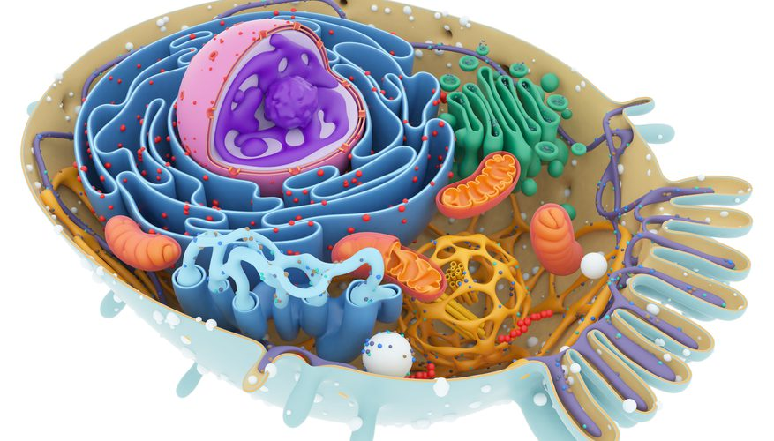
Types of macromolecules
Type of Macromolecules
Nucleic acid: including DNA {Deoxyribonucleic acid} and RNA {Ribonucleic acid}
Protein
Polysaccharide

Slide 3
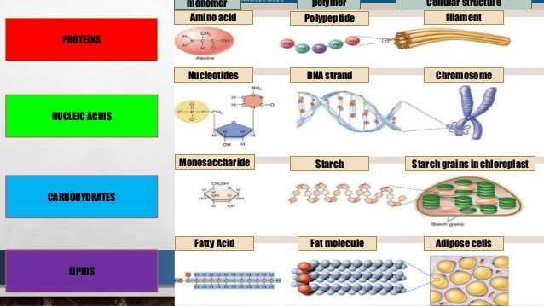

Slide 4
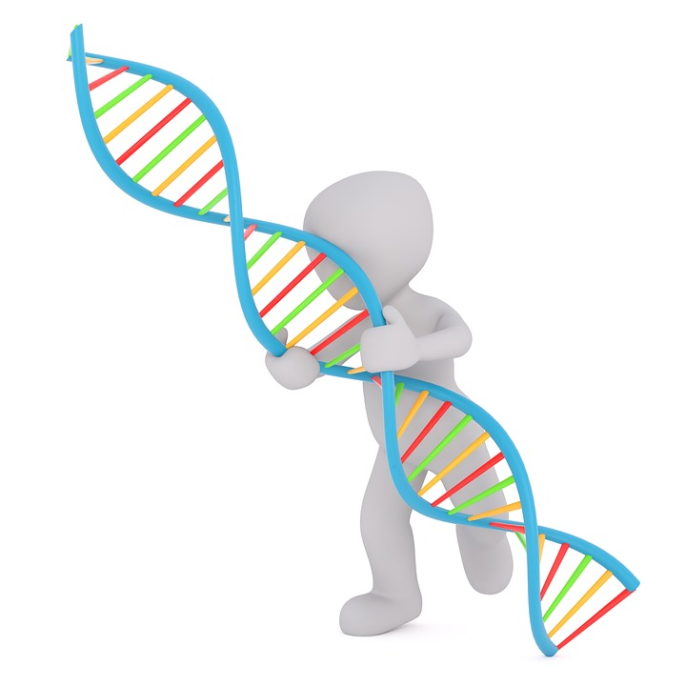
The Nucleic Acids:
DNA is the most important molecule in living cells and contains all the information that the cell need to live and to propagate itself with RNA they maintain the cell through gene expression. Nearly all of the DNA present in eukaryotic cells can be found in the cell nucleus but it is present in cytoplasm in bacteria.

Slide 5
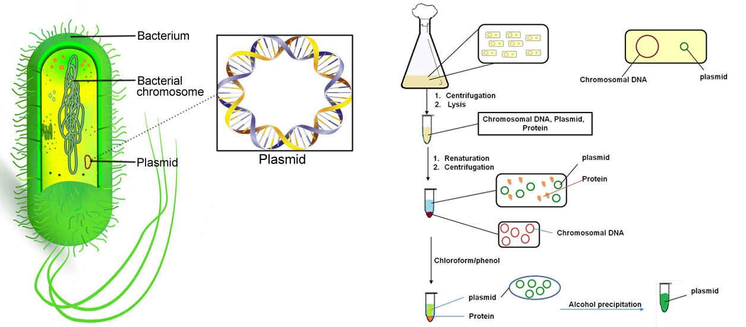
Other type of DNA rather than chromosomal DNA
Plasmid DNA: it is a double stranded super helix DNA (extra chromosomal genetic material) usually found in bacterial cytoplasm. Plasmids are not confined to bacteria but they have been isolated from yeast, protozoa and plants.

Slide 6
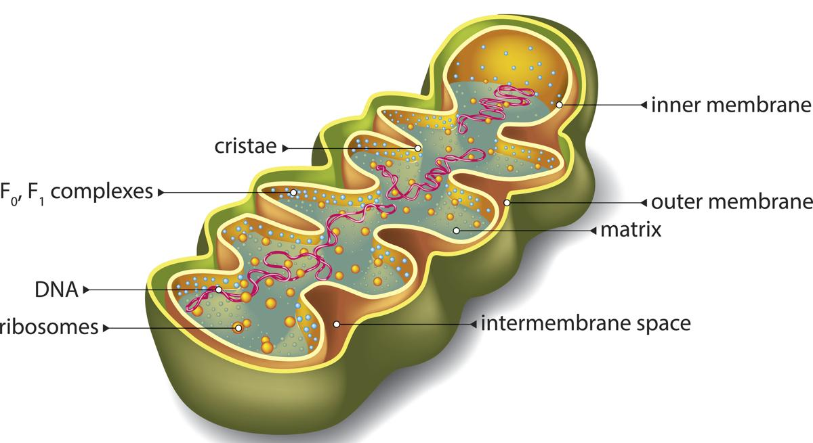
Mitochondrial DNA (mtDNA or mDNA) is the DNA located in organelles called mitochondria, structure within eukaryotic cells that convert chemical energy from food into a form that cells that convert chemical energy from food into a form that cells can use, adenosine triphosphate (ATP). In humans, mitochondrial DNA can be assessed as the smallest chromosome coding for only 37 genes and containing only about 16,600 base pairs. Human mtDNA was the first significant part of the human genome to be sequenced.

Slide 7
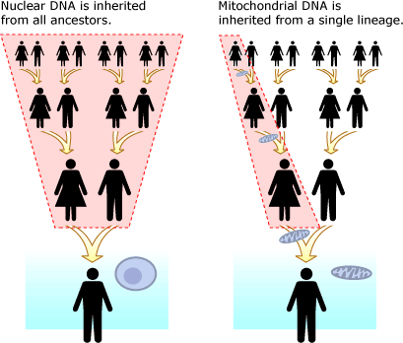

Slide 8
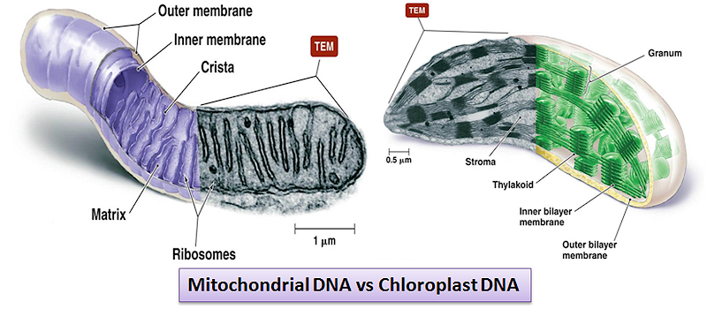
Chloroplast DNA: present inside chloroplast responsible for its activity.

Slide 9
Basic structure of DNA
A nucleic acid is a polymer consisting from nucleotides (the main structural units in nucleic acid) each nucleotide has the 3 following components:
Cyclic five carbon sugar called ribose (in RNA) and as it devoid hydroxyl group attached to carbon no. 2 DNA structure thus it called deoxyribose
Nitrogen base the purine {adenine A and guanine G} and pyrimidine {cytosine C, thymine T, and uracil U} the first type consisting from 2 rings while second while second type contain only one ring.

Slide 10
A phosphate group (phosphoric acid) attached to the 5 carbon atom of the sugar by a phosphoester linkage. This phosphate group is responsible for the strong negative charge of nucleic acid.
5-Nitrogen base: A, T, C, G without U (Uracil only in RNA). The backbone of DNA is the sugar-phosphate

Slide 11
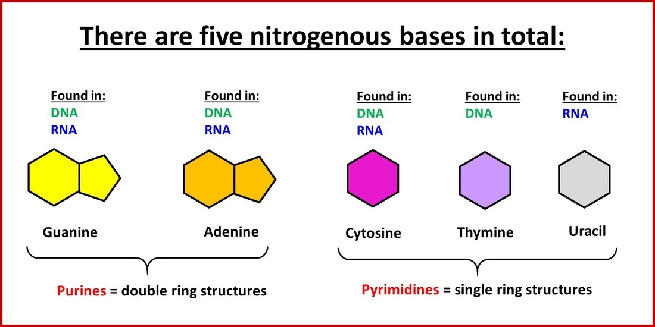

Slide 12
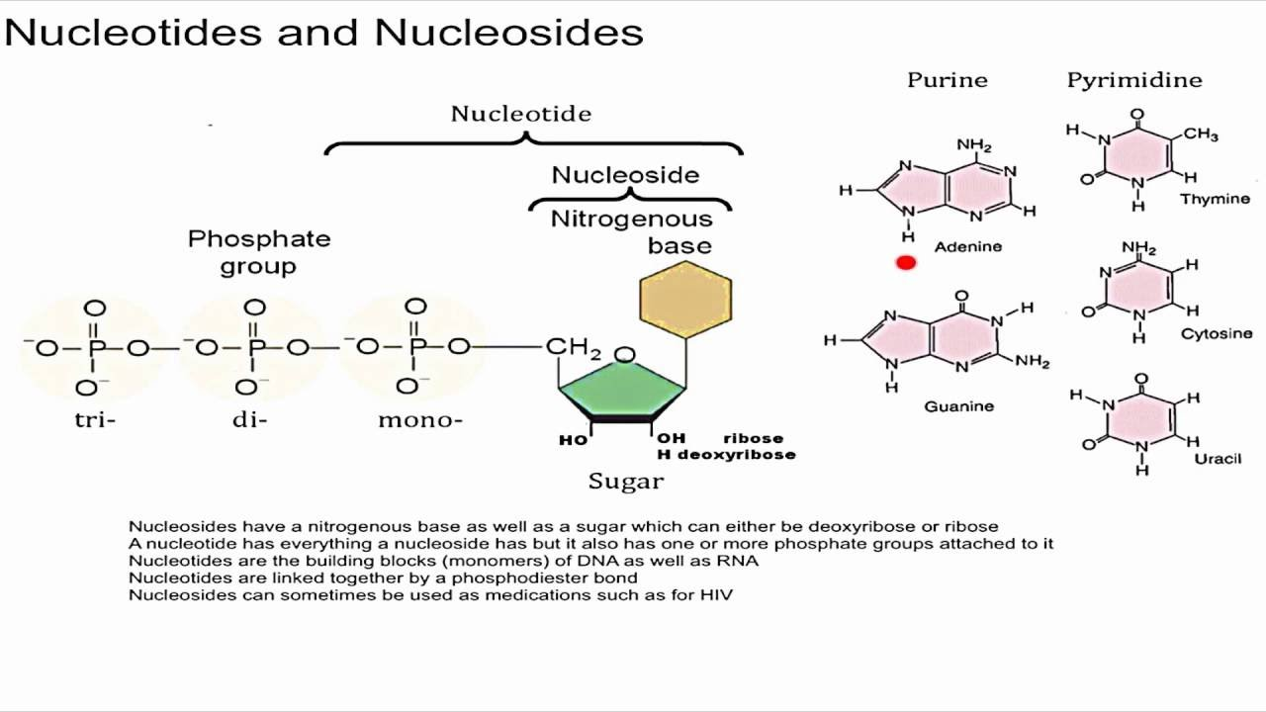
N base+ sugar --→ Nucleoside via N-glycosylic bond
N base+ sugar + phosphate group -→ Nucleotide (the basic unit in nucleic acid)

Slide 13
According to nitrogen base type the nucleotide is named
Base | Nucleoside | Nucleotide | RNA (mono-Pi) | DNA (mono-Pi) | Code
Adenine | (deoxy-)Adenosine | (deoxy-)Adenylic acid | AMP | dAMP | A
Guanine | (deoxy-)Guanosine | (deoxy-)Guanylic acid | GMP | dGMP | G
Cytosine | (deoxy-)Cytidine | (deoxy-)Cytidylic acid | CMP | dCMP | C
Thymine | Thymidine | Thymidylic acid |  | dTMP | T
Uracil | Uridine | Uridylic acid | UMP |  | U

Slide 14
**Nucleosides are named by adding the suffix "-idine" to the pyrimidine or "-osine" to the purine name

Slide 15
Conformation of the nitrogenous bases in nucleoside molecules
Rotation around the glycosidic bond is restricted due to the presence of the hydrogen of the C2' carbon of the ribose
There are two general orientations of the base: syn and anti
Either form is allowed for purine nucleosides. However, the anti form is favored for the pyrimidine nucleosides.

Slide 16
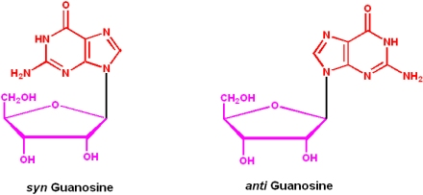

Slide 17
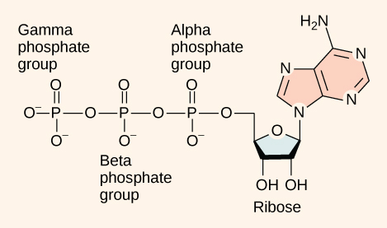
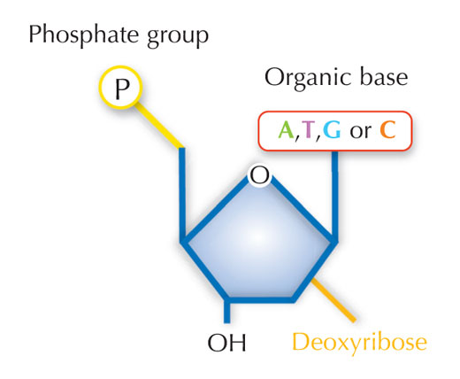
For the phosphate group:
Usually the nucleotide comes with 3 phosphate group (α, β, and ϒ). When it binds to DNA strand, it will lose two groups (pyrophosphate) leafing only one group α attached to the helix. The attachment will be then only from one side (the 3`OH free end).

Slide 18
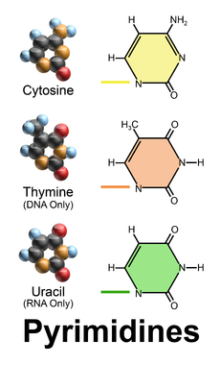
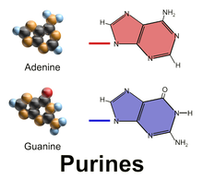
Purine and Pyrimidine in DNA
Purines and Pyrimidines are nitrogenous bases that make up the two different kinds of nucleotide bases in DNA and RNA. The two-carbon nitrogen ring bases (adenine and guanine) are purines, while the one-carbon nitrogen ring bases (thymine and cytosine) are pyrimidines.

Slide 19
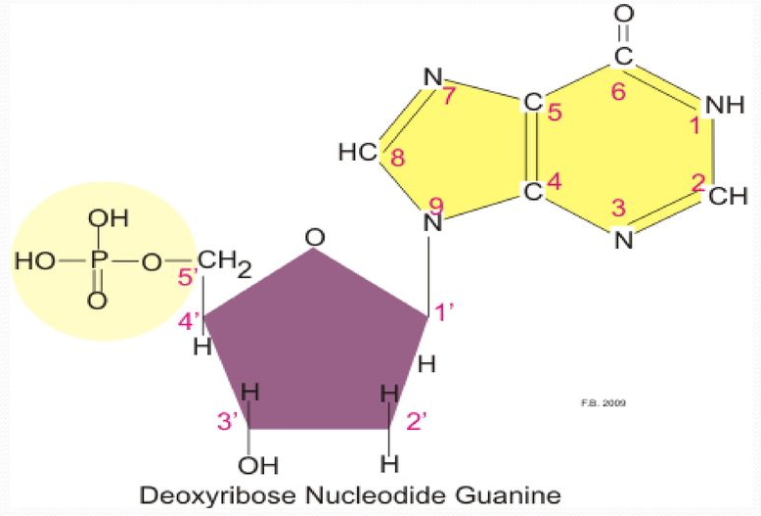
Carbon no. 1 in sugar attaches to nitrogen No. 9 in case of purine.

Slide 20
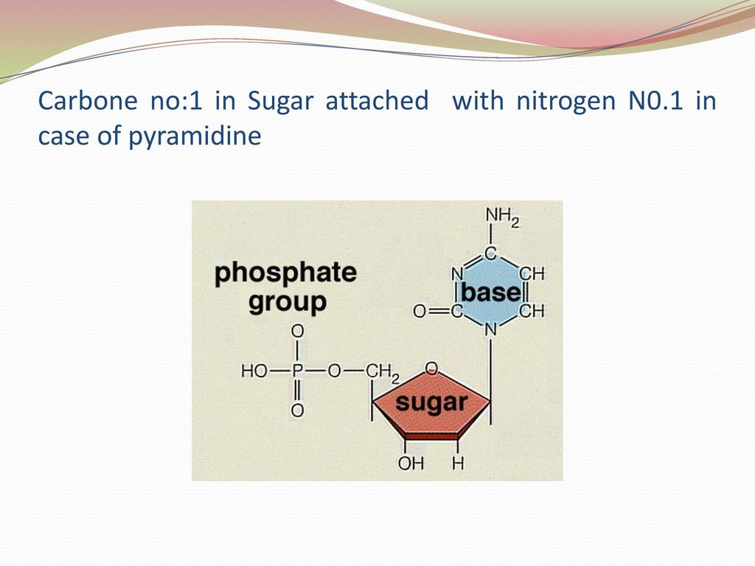
Carbon no.1 in sugar attaches to nitrogen No. 1 in case of pyrimidine

Slide 21
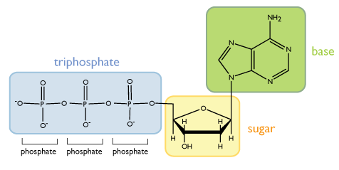
Types of covalent Bonds
The bond between base and sugar is n-glycosidic bond ( always b type)
The bond between sugar and phosphate is ester bond
The bond between 2 bases is hydrogen bond
Ester bond
Glycosidic bond

Slide 22
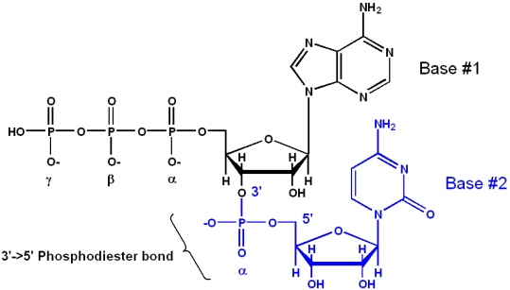
3`---5` phosphodiester bond:
-The primary structure of DNA represent one single strand, not branched, result from binding polymer of nucleotides between the 3` OH free end of the upper sugar with the 5` P end of the following nucleotide. Therefore, the bond between two adjacent nucleotides is 3`--5` phosphodiester bond to form oligonucleotide.

Slide 23
-Oligonucleotides, regardless of length, have a "5' end" and a "3' end". The frame of reference for these polymers (polynucleotides) is that the 5' end is the "start" and the 3' end is the "end“
-The 5' end of polynucleotides typically is phosphorylated (with a monophosphate; the triphosphate on the 5' end in the above diagram is there to show why it is the α-phosphate that is retained upon incorporation of a new NTP). The 3' end is typically a hydroxyl.

Slide 24
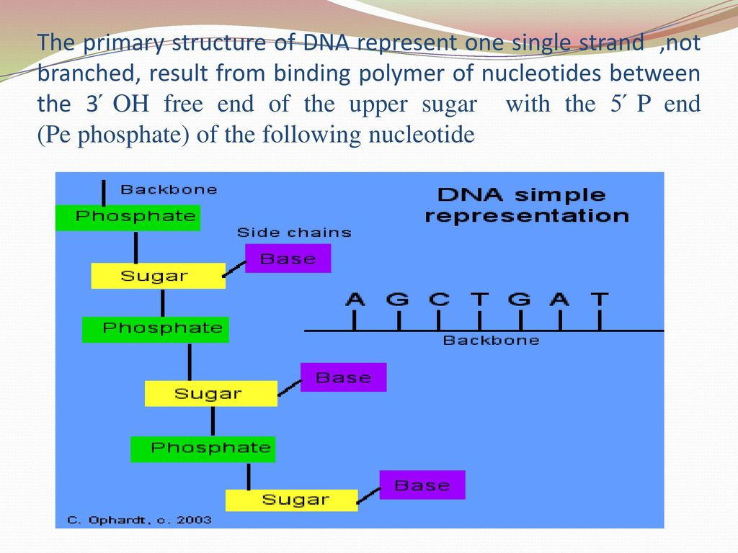

Slide 25
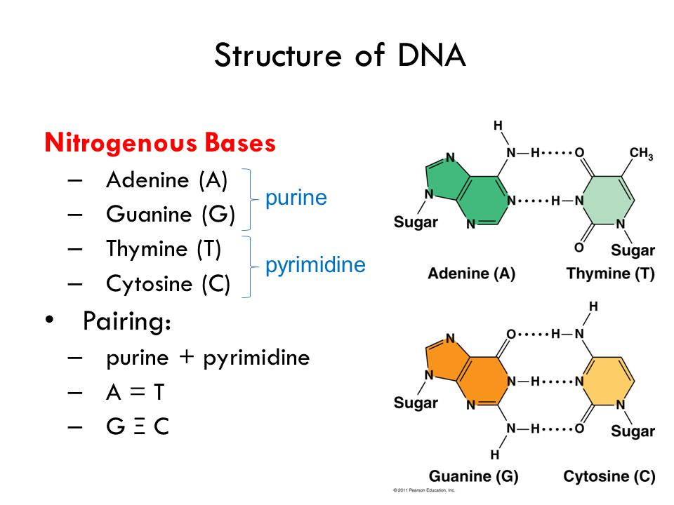
Hydrogen Bond
-DNA contains four bases: Guanine, Cytosine, Adenine, and Thymine. The complementary base pairs of guanine with cytosine and adenine with thymine connect to one another using hydrogen bonds. These hydrogen bonds between complementary nucleotides are what keeps the two strands of a DNA helix together.

Slide 26
-Each base can also form hydrogen bonds with the external environment such as with water. Although these internal and external hydrogen bonds are fairly weak, the consolidated power of all the millions of hydrogen bonds in DNA makes it a stable molecule. Also, the hydrogen bonds on the phosphate groups on each nucleotide interact inducing two strands of DNA to conform to a helical structure
The bases are precisely held by hydrogen bonding with the energy of 1 to 5 kcal/ mol.

Slide 27
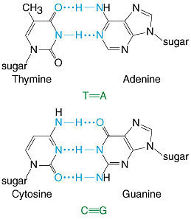

Slide 28
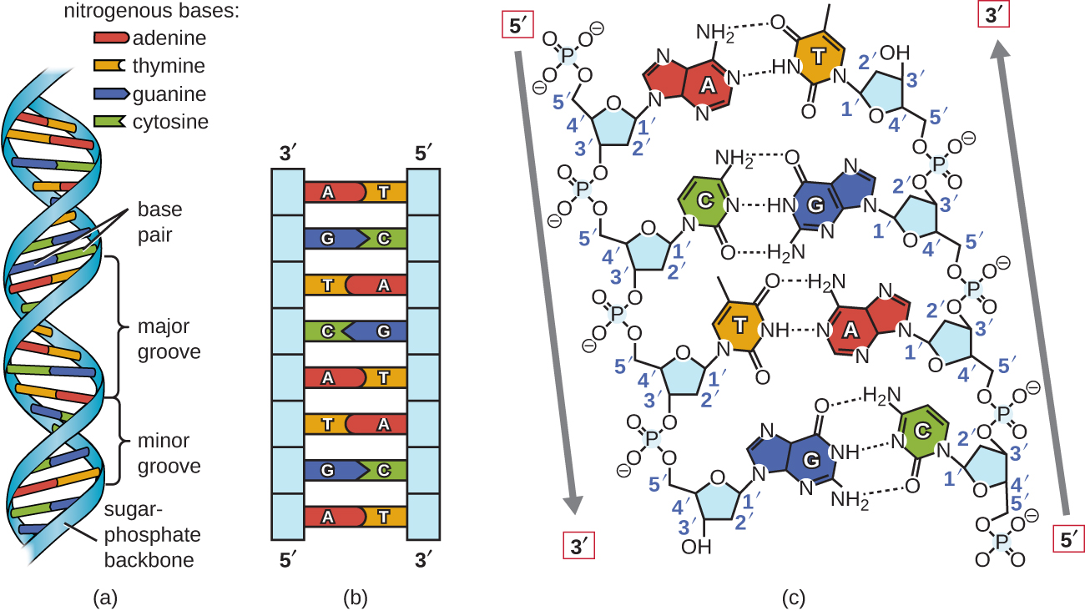
By binding between nucleotides on the two DNA strands, Secondary structure of DNA will be formed. This form called Double helix DNA.

Slide 29
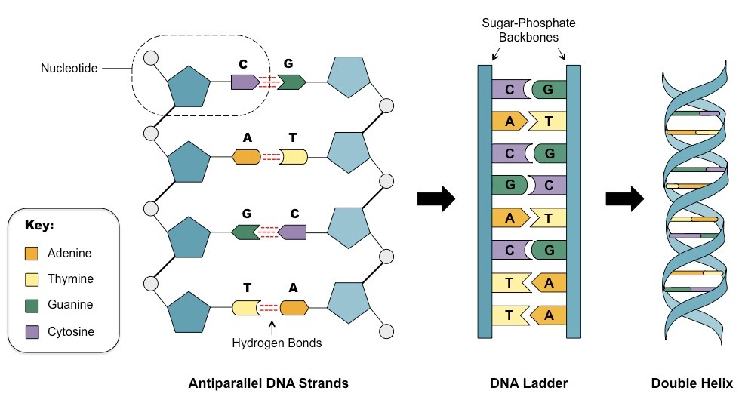

Slide 30
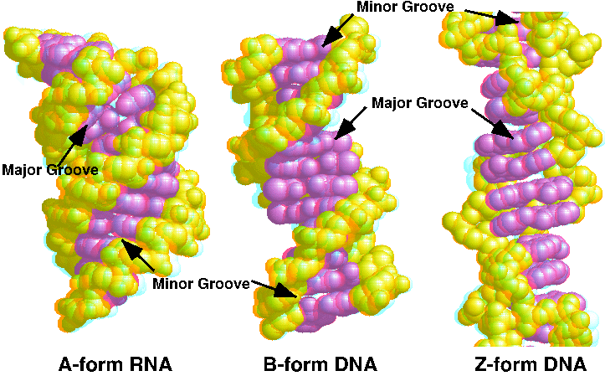
Types of Double Helix DNA:
  A-form DNA
  B- form DNA
  Z-form DNA

Slide 31
The basic roles in DNA double helix B form:
Purines equal to pyrimidine bases within the antiparallel strand
The DNA double helix is stabilized primarily by two forces: hydrogen bonds and stacking interaction among aromatic nucleobases.
It contains 2 grooves, the major groove which is 22A wide and the minor groove which is 12A wide.
The backbone directed outside the helix while the nucleotides oriented inside.

Slide 32
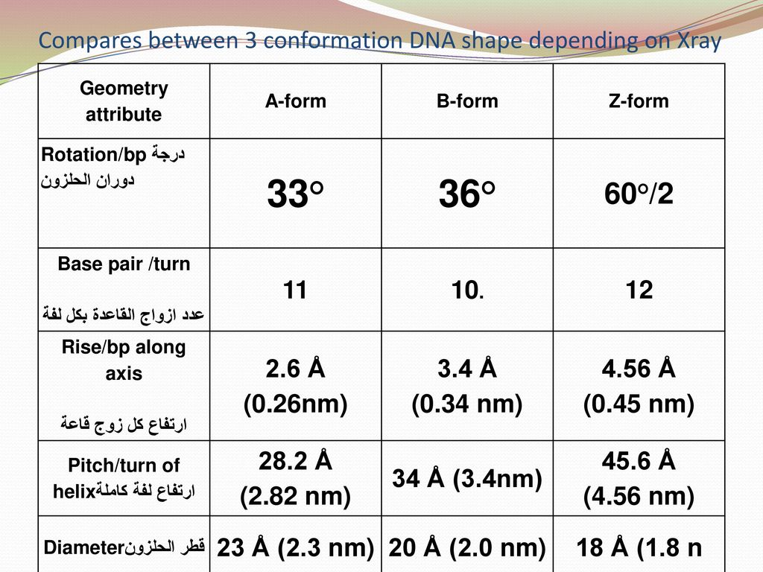
The basic geometry attributes differences between these forms are presented in the table below:

Slide 33


